Slide 1

EVivaX
Portable Battery for Electric Vehicle
Group 20 Presenters:
Burz, Gozde McGerr, Irie Yee, Luiz Santana, Sawsan, Surya Manduri, Tayo Ojulari
Notes:
Requesting for £500k funding for a 15% share of the company from Bisons investors today.
£140k in total from 7 investors for the idea & concept.

Slide 2

Burz
01 Introduction & Problem Statement
02 Product Proposition
03 Market Outlook
04 Target Consumer Analysis
05 Mkt Strategy & Financial Projection
06 Summary & Conclusion
07 Appendix

Slide 3
Introduction & Problem Statement
Burz
The future of transportation is electric, but the infrastructure to support it is not there yet.
Limited access to reliable charging infrastructure for electric vehicles in rural areas, leading to EV owners experiencing range anxiety during long journeys.
Notes:
Explain - WHAT’s the problem (you may elaborate with your own words) and
WHY , as an potential investor, why they should take this opportunity to hear us today to have the understanding of the Market Opportunity -the size and growth potential of the target market. What we are offering will meet the real need and has a large enough addressable market to support significant growth.

Slide 4
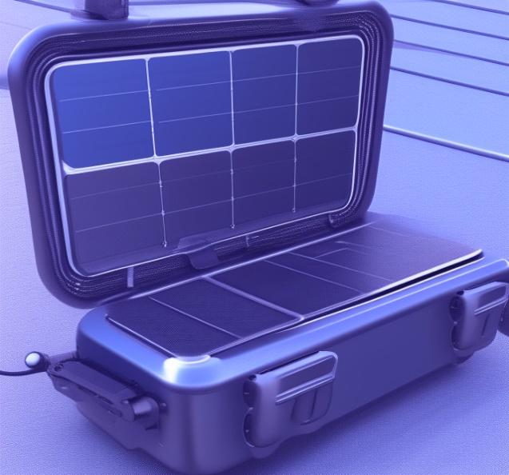
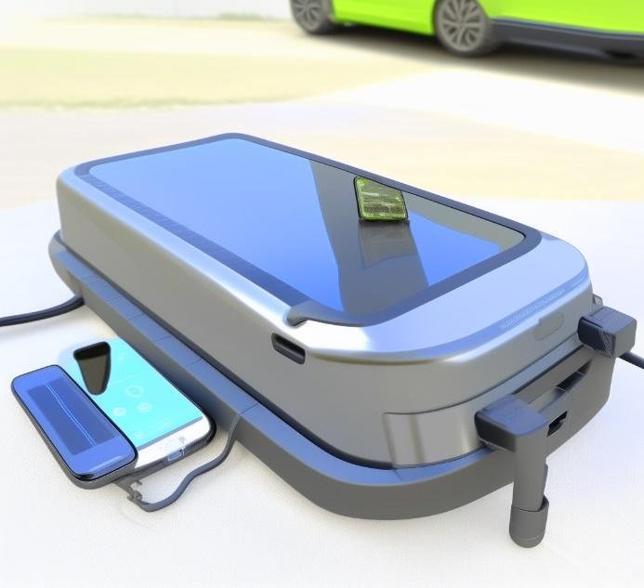
Product Value Proposition
Surya
Lithium-ion Batteries
Foldable solar panels provide up to 1.2kW
Battery capacity of 20kWh
Supports Level 2 AC charging and CCS DC fast charging
Retractable cables and adapters for J1772 and CCS standards
Digital display shows charge level, solar collection, charging speed
Wheels and handle for portability
For Technical Specification, click HERE
Quick Charging
Portability
High Energy Density
3x more faster rate in comparison
Solar chargeable with or without electrical point
High energy-to-weight ratio, powering EV for longer distance
EVivaX combines ‘EV’ (Electric Vehicle) with ‘viva’ (meaning life).
Represents the lively and eco-friendly charging solution for EVs.
Notes:
A Portable EV Battery Powerbank that offers quick charging, portability, and high energy density, providing EV owners with a convenient and efficient charging solution, even in remote locations.
The EvivaX is an innovative new product that provides a portable, renewable charging solution for electric vehicles. With a foldable design and integrated solar panels, it gives EV owners the flexibility to charge anywhere, anytime - eliminating range anxiety and enabling adventures off-the-grid.
Product Overview:
The EvivaX features a suitcase-style enclosure on wheels for maximum portability. Four high-efficiency monocrystalline solar panels unfold to harvest sunlight and deliver up to 1.2kW of power. This charges the integrated 20kWh Lithium Iron Phosphate battery, which offers long cycle life and safety.
The user can choose between two output modes:
Level 2 AC charging up to 3kW via a standard J1772 connector
DC fast charging up to 30kW via the CCS2 standard
This rapid charging capability allows the EvivaX to completely replenish most EV batteries in just 2-3 hours in optimal conditions.
The EvivaX also contains an onboard solar charge controller to optimize energy harvest. The system is completely self-contained and weatherproof rated at IP65. Easy maneuverability is enabled by the integrated handle and wheels.
When solar charging is not practical, the EvivaX can be recharged from any wall outlet. The interactive LCD screen provides charging status and system information.
As MVP, the key features that will be incorporated offers the following:
Quick Charging: Lithium-ion batteries for electric vehicles offer the advantage of quick charging. They have the ability to recharge at a faster rate compared to other battery technologies. This means that electric vehicle owners can significantly reduce the time required to charge their vehicles, making it more convenient and efficient. Quick charging also enhances the usability and practicality of electric vehicles, as it allows for shorter charging stops during long journeys.
Portable & Lightweight: Lithium-ion batteries are known for their portability and lightweight nature. They have a high energy-to-weight ratio, which means they can store a large amount of energy while still maintaining a relatively low weight. This characteristic is crucial for electric vehicles as it contributes to overall weight reduction, improving the vehicle's efficiency and extending its driving range. Additionally, the portability and compactness of lithium-ion batteries make them easier to install and integrate into electric vehicle designs.
High Energy Density: Energy density refers to the amount of energy that can be stored in a given volume or mass of a battery. Lithium-ion batteries have a high energy density, which means they can store a significant amount of energy in a compact size. This is particularly important for electric vehicles, as it allows them to carry a sufficient amount of energy to power the vehicle for longer distances. High energy density batteries provide electric vehicles with extended driving ranges and enable them to compete with traditional internal combustion engine vehicles in terms of mileage.
In summary, lithium-ion batteries for electric vehicles possess key features such as quick charging, portability and lightweight design, and high energy density. These features contribute to the overall performance, convenience, and viability of electric vehicles by reducing charging time, enabling easier installation, and providing extended driving ranges.
While the EV market is competitive, there is a growing demand for innovative and convenient charging solutions. Our Portable EV Battery Powerbank sets itself apart from traditional charging stations and other powerbanks with its quick charging, portability, and high energy density features.

Slide 5
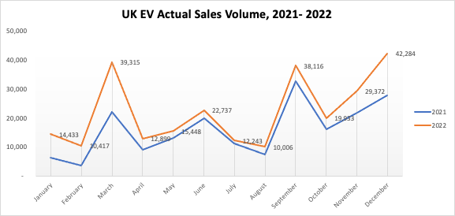
EV Industry Outlook
Tayo
21.9%
Apr 2023 SoS,
△16.2% YoY⁶
23.76%
EV CAGR Projection¹
Government Support⁷
Tech advancement⁸
Consumer demand⁹
18%
Overall Market Share
for Battery-CV²
£15.66bn
2023 Revenue Projection
810,000
Electric Cars (June 23)⁴
573.10k
Projected EV sales by 2028
£21.37bn
2028 Projected Mkt Volume
Notes:
Market Trends
The increase in environmental consciousness, government support, and growing availability of EVs in the UK market are driving the adoption of electric vehicles. Our Portable EV Battery Powerbank aligns perfectly with these trends, offering a convenient and eco-friendly charging solution.
CAGR
UK Electric Vehicle Market is Poised to Grow at a CAGR of 23.76% by 2028. key factors for market growth are increasing consumer demand, greater availability of vehicles, and government support.
Increasing availability: As the demand for EVs has grown, more automakers have started producing EVs, which has increased the availability of EVs in the UK market[9].
Government support: The UK government has adopted stringent regulations regarding vehicle carbon emissions and offers subsidies for the adoption of EVs, which has pushed the demand for passenger vehicles in the UK market^{[7]}
Charging infrastructure: The UK has been investing heavily in its charging infrastructure, with over 21,906 EV charging locations, including slow, fast, rapid, and ultra-rapid charging stations[5]. This has made it easier for EV owners to charge their vehicles, which has contributed to the growth of the EV market.
Technological advancements: The development of new and improved EV models with longer driving ranges and faster charging times has made EVs a more attractive option for consumers[8].
The UK electric vehicle market is projected to grow at a robust CAGR of more than 14% by 2026
Revenue
Revenue in the Electric Vehicles market is projected to reach £15.66bn in 2023.
Revenue is expected to show an annual growth rate (CAGR 2023-2028) of 6.41%, resulting in a projected market volume of £21.37bn by 2028.
The total revenue of the UK electric vehicle market is expected to grow at 14% through 2021 to 2027, reaching nearly USD 7.88 Bn. by 2027
Unit Sales
The volume weighted average price of Electric Vehicles market in 2023 is expected to amount to £41.55k.
By 2026, they’re expected to account for a fifth of vehicle sales. (Source: PWC - https://www.pwc.co.uk/industries/real-estate-and-infrastructure/real-assets/investment-opportunity-electric-vehicle-fleet.html)
Revenue is expected to reach £15.66bn in 2023,
Electric Vehicles market unit sales are expected to reach 573.10k vehicles in 2028.
Factors
All new cars and vans sold in the UK must be fully electric by 2035. The government is currently on course to ban the sale of new cars and vans powered entirely by petrol and diesel by 2030 and ban the sale of new hybrid vehicles by 2035. (Source: SMMT, DfT)
Overall, the market share of EVs in the UK is growing, with battery-electric vehicles leading the way.
The increase in market share of electric vehicles (EVs) in the UK can be attributed to several factors, including:
- Environmental consciousness: There is an increasing awareness of the impact of traditional fuel vehicles on the environment, which has led to a growing interest in EVs as a more eco-friendly alternative[1].
- Increasing availability: As the demand for EVs has grown, more automakers have started producing EVs, which has increased the availability of EVs in the UK market[6].
Overall, the combination of these factors has contributed to the steady increase in market share of EVs in the UK.

Slide 6
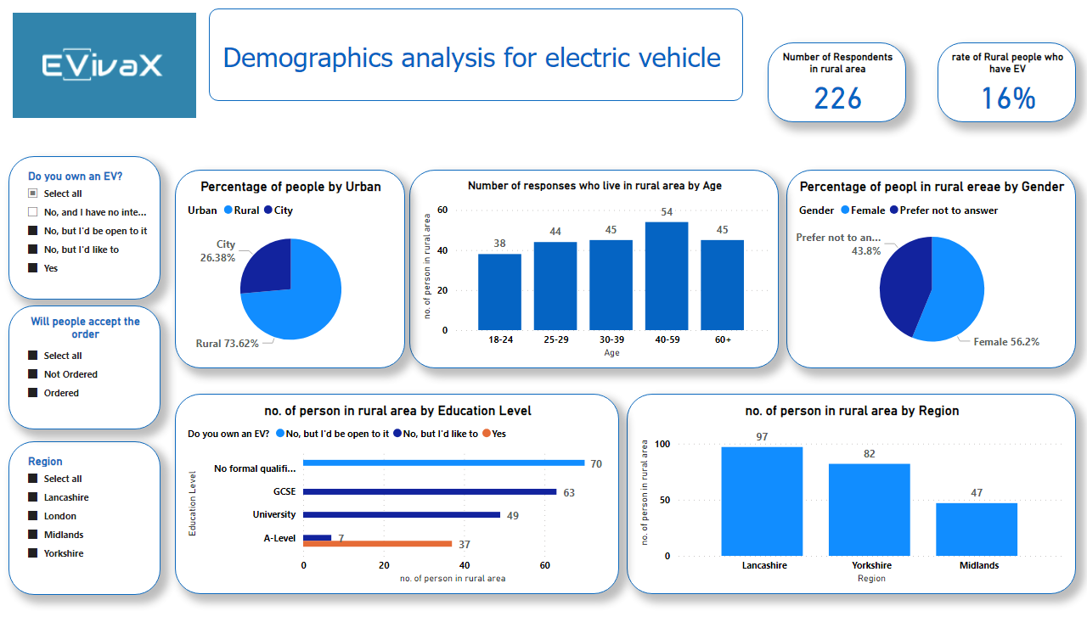
Analysis - Demographics
Total Respondents: 375
Gozde
Notes:
Total Respondents: 375 Respondent
Total # of people owing EV + interested: 307 (including City)
Total # of people owing EV + interested + in Rural regions: 226 (16% have EV car)(Lancashire, Yorkshire, Midland)
Key Message: Target Pilot Area - (Rural - 3 Areas), Marketing Content specifics to Female, People whom are interest spread across all ages range and across all education level.
Our target audience for the Portable EV Battery Powerbank includes:
Age: All ranges
Gender: Female
Location: Rural areas
Education Level: Mix of levels
Characteristics: Cost-conscious, seeking reliable charging in remote locations
**Geographic Analysis:**
The data shows the highest interest and orders for the powerbank come from rural, whilst most that already ordered EV battery is from Yorkshire. The 3 Rural areas are the ideal pilot area for the initial product launch.

Slide 7
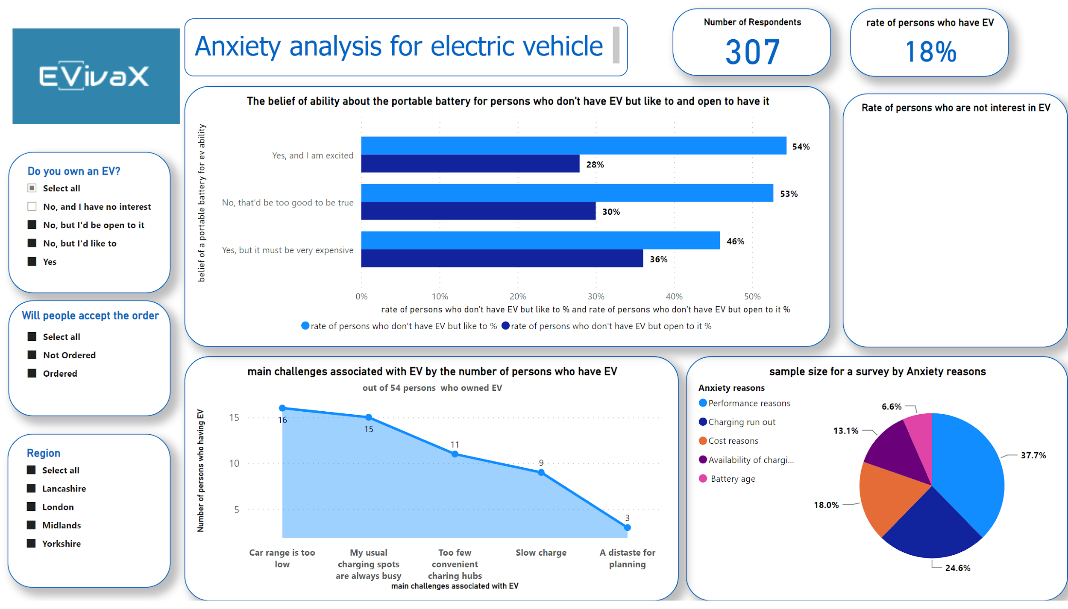
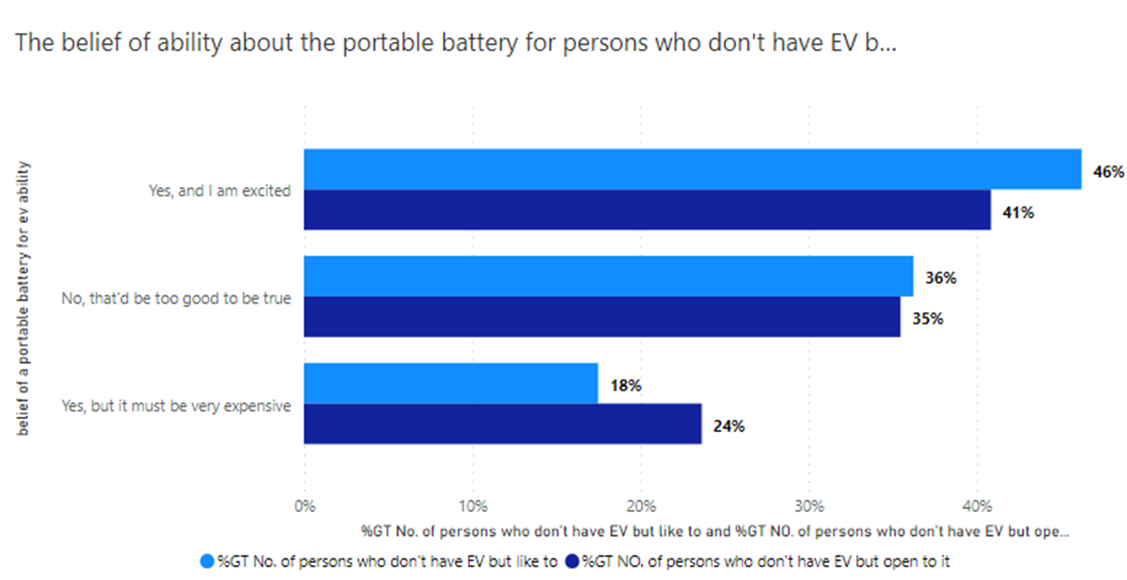
Analysis - Key Feedback
Sawsan
The belief of ability about the portable battery for persons who don't have EV but like to and open to have it
Notes:
Total respondents provided feedback as to whether they are open to get the Battery.
And shared what is their
(1) Anxiety - main concern (from those who potentially don’t have EV)
(2) Problem/challenge (from those whom have EV)
Top Graphs - indicates the interest/belief regards to this new technology ---- Respondents that currently who don’t have EV.
**Customer Feedback on Battery Orders:**
Customers who have already ordered the Portable EV Battery Powerbank appreciated its ease of use, allowing them to charge their EVs even in areas with limited charging infrastructure.
**Customer Interest and Concerns:**
Based on data analysis, potential customers are interested in quicker charging options and concerns about finding charging stations on long journeys.

Slide 8
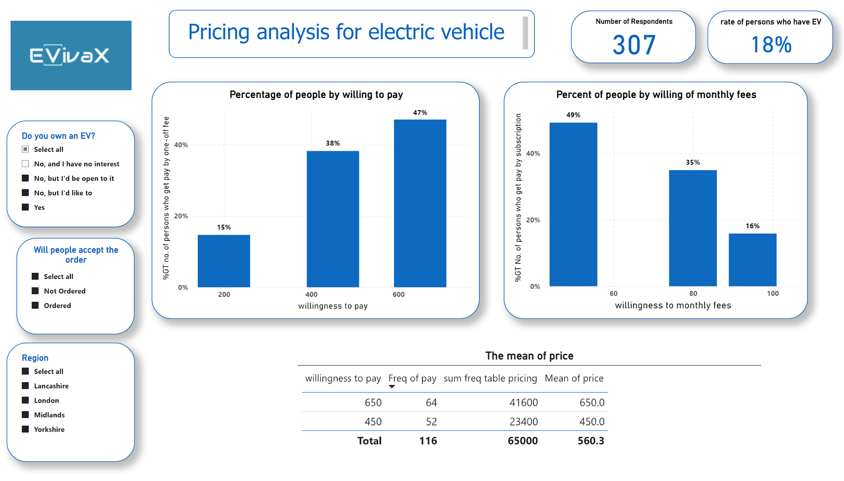
Analysis – Pricing Analysis
Sawsan
Notes:
Graphs indicate Rate of Person whom have ordered the Battery to date.
Depicts what price points and pricing method that people are willing to pay.
% prefer One-Off model
For those whom prefer one-off payment, 38% of 307 respondents are willing to pay £450, and 47% are willing to pay 500 for a more reliable, eco-conscious better.
% prefer Subscription (Monthly) model
For those whom prefer Monthly payment, 43.5% of 126 respondents are willing to pay £95 monthly. & 43.1% opted for £50 monthly. All of the people who has ordered opted for £50. (This is the price point for the Prototype)
**Pricing Strategy:**
- One-Time Purchase: £600
- Monthly Subscription: £50/month (At least 12 months, renewable for one-month rolling contract afterwards)
**Rationale:**
The pricing model aims to cater to cost-conscious rural female buyers in the target audience. The one-time purchase option provides flexibility for customers who prefer to own the powerbank outright. The monthly subscription model allows customers to access the powerbank at an affordable cost, ensuring reliable charging for a minimum of 12 months and potentially increasing profitability per client with renewal contracts.

Slide 9
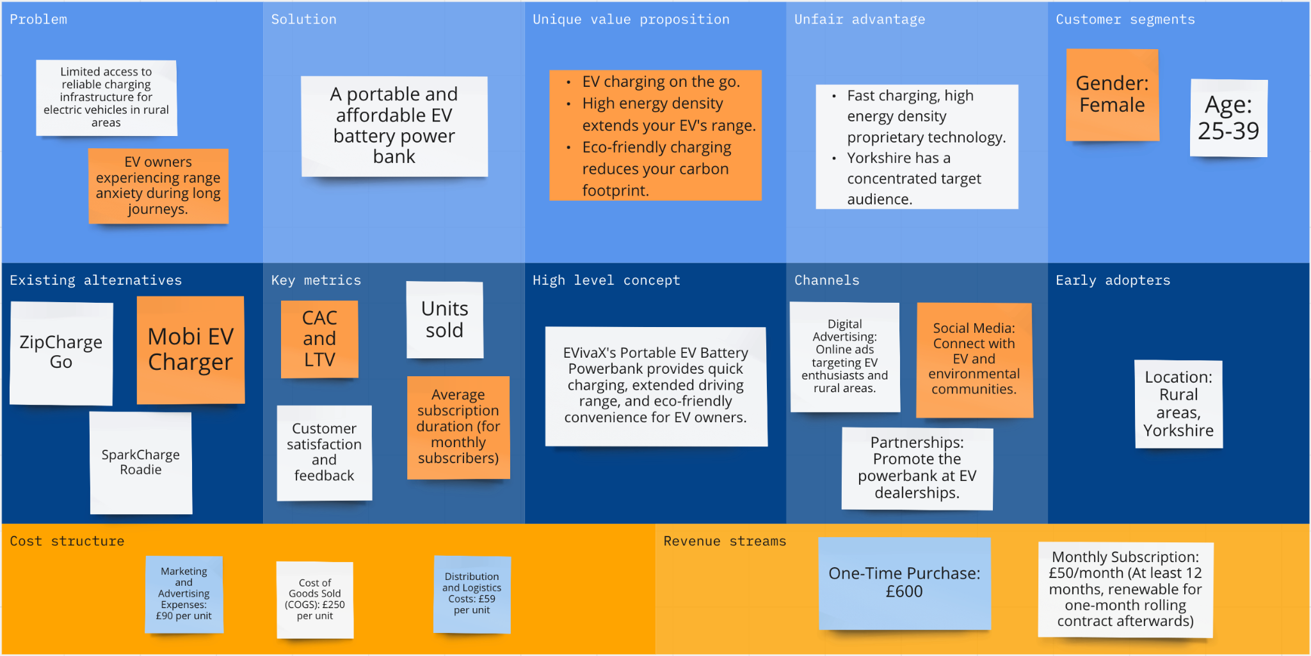
Lean Canvas
Location:
Rural areas:
Lancashire
Yorkshire,
Midlands
One Time Purchase
£560
Notes:
Update ONe Time Purchase = £560

Slide 10
Financial Projection
Seed Fund & ROI
1
£100,000
2
£250,000
3
£500,000
Year 1:
- Units Sold: 498 (One-Time Purchase)
- Revenue: £298,800 (£600 x 498)
- Variable Costs: £29,382 (£59 x 498)
- Fixed Costs: £150,000
- Net Income: £119,418
Year 2:
- Units Sold: 527 (12mth Subscription)
- Revenue: £317,100 (527 subscribers x 12 months x £50)
- Variable Costs: £31,118 (£59 x 527)
- Fixed Costs: £150,000
- Net Income: £136,982
Year 3:
- Units Sold: 635 (12mth Subscription)
- Revenue: £381,000 (635 subscribers x 12 months x £50)
- Variable Costs: £37,565 (£59 x 635)
- Fixed Costs: £150,000
- Net Income: £193,435
Year 1:
- Units Sold: 498 (One-Time Purchase)
- Revenue: £298,800 (£600 x 498)
- Variable Costs: £29,382 (£59 x 498)
- Fixed Costs: £150,000
- Net Income: £119,418
Year 2:
- Units Sold: 750 (12mth Subscription)
- Revenue: £450,000 (750 subscribers x 12 months x £50)
- Variable Costs: £44,250 (£59 x 750)
- Fixed Costs: £150,000
- Net Income: £255,750
Year 3:
- Units Sold: 944 (12mth Subscription)
- Revenue: £566,400 (944 subscribers x 12 months x £50)
- Variable Costs: £55,796 (£59 x 944)
- Fixed Costs: £150,000
- Net Income: £260,604
Year 1:
- Units Sold: 498 (One-Time Purchase)
- Revenue: £298,800 (£600 x 498)
- Variable Costs: £29,382 (£59 x 498)
- Fixed Costs: £150,000
- Net Income: £119,418
Year 2:
- Units Sold: 1,000 (12mth Subscription)
- Revenue: £600,000 (1,000 subscribers x 12 months x £50)
- Variable Costs: £59,000 (£59 x 1,000)
- Fixed Costs: £150,000
- Net Income: £391,000
Year 3:
- Units Sold: 1,200 ((12mth Subscription)
- Revenue: £720,000 (1,200 subscribers x 12 months x £50)
- Variable Costs: £70,800 (£59 x 1,200)
- Fixed Costs: £150,000
- Net Income: £499,200

Slide 11
Questions
Location:
Rural areas:
Lancashire
Yorkshire,
Midlands
One Time Purchase
£560

Slide 12
Appendix

Slide 13
Technical Specification
Solar Panels: Four foldable 300W panels, monocrystalline silicon cells, 22% efficiency rated, 1.2kW total
Batteries: Lithium-ion phosphate (LFP) chemistry, 300V system voltage, 20kWh total capacity
AC Charger: 3kW max output, J1772 connector
DC Fast Charger: 30kW max output, CCS2 connector
MPPT Solar Charge Controller: 99% peak efficiency, 150V DC input
Enclosure: ABS plastic, IP65 weatherproof rating, retractable cable spools
Wheels: 9 inch pneumatic tires
Dimensions: 30 x 20 x 12 inches (expanded), 14 x 14 x 8 inches (folded)
Weight: 55 lbs
Batteries:
Cell chemistry: Lithium-ion phosphate (LFP)
Voltage: 3.2V nominal per cell
Capacity: 20Ah per cell
Quantity: 100 cells in modular packs
Pack Configuration: 50 parallel groups of 2 cells in series
Total Capacity: 20kWh
Cycle life: >2000 cycles and 6 years
Thermal management: Liquid cooling plates for cell packs
Solar Panels:
Rated Power: 300W per panel
Cell Type: Monocrystalline silicon
Efficiency: 22%
Open Circuit Voltage: 48V
Weight: 15 lbs per panel
Dimensions: 40 x 28 x 1.8 inches each panel
Mount: Foldable kickstand legs

Slide 14
Challenges
Lack of charging infrastructure
Power System strain
Battery technology & repair
Cost and range
Idling concerns
Notes:
- Lack of charging infrastructure: A lack of charging infrastructure is a significant challenge facing EV manufacturers in the UK. A recent survey by Kwik Fit found that 37% of respondents cited a lack of charging points in their area as the most important reason for preventing them from buying an EV[2]. Unequal access to charging infrastructure could result in an unequal uptake of EVs worldwide, slowing the switch to more greener forms of transport[2].
- Battery technology and repair: A lack of data on EV batteries continues to challenge insurers who are forced to scrap EVs after mild accidents, potentially undermining EV adoption[3]. EV-related insurance claims are already 25.5% more expensive than for fossil-fuel equivalents and take 14% longer to repair[3]. There is also a shortage of skilled technicians who can effectively work on the growing number of EVs on UK roads[4].
- Idling concerns: The effects of the weather and idling concerns are also a concern for EV owners. Cold weather can reduce the range of EVs, and idling can drain the battery[4].
- Cost and range: Although the cost and range of EVs are improving all the time, they remain a challenge for EV manufacturers in the UK. EVs are still more expensive than traditional fuel vehicles, and the range of EVs can be limited compared to traditional fuel vehicles[1].
- Power system strain: If EVs become ubiquitous, then the local power system is going to be put under intense strain. If the whole of the UK vehicle fleet were to be electrified, it could double national electricity use and have a big impact on peak demand. Additional generating, transmission, and distribution capacity could be provided, but at a hefty price and involving much disruption[1].
Overall, these challenges need to be addressed to drive the adoption of EVs in the UK.
Citations:
[1] https://www.mottmac.com/views/massive-challenges-ahead-as-uk-moves-to-electric-vehicles
[2] https://dis-blog.thalesgroup.com/iot/2022/03/08/electric-cars-four-challenges-manufacturers-need-to-address-to-drive-adoption/
[3] https://www.reuters.com/business/autos-transportation/ev-batteries-remain-major-challenge-insurers-uks-thatcham-2023-07-04/
[4] https://www.rivusgroup.co.uk/common-challenges-with-electric-vehicles-and-how-to-overcome-them/
[5] https://www.cnbc.com/2023/05/17/stellantis-warns-of-uk-exodus-of-ev-production-under-post-brexit-rules.html
[6] https://www.mondaq.com/uk/rail-road--cycling/1150728/the-electric-vehicle-industry-the-next-big-challenges

Slide 15
SWOT Analysis
Strengths
Weaknesses
Limited market share due to competition from established battery manufacturer
High initial investment required for research and development, manufacturing, and marketing
Limited charging infrastructure for electric vehicles, which may limit the adoption of portable batteries
New technology that provides better performance and longer lifespan compared to existing batteries
Portable design that allows for easy charging and replacement of batteries
Potential for cost savings and environmental benefits for consumers
S
W
O
T
Growing demand for electric vehicles and associated products, including batteries
Potential for partnerships with electric vehicle manufacturers to provide portable battery solutions
Potential for expansion into international markets
Competition from established battery manufacturers
Rapidly evolving technology that may make the new battery technology obsolete
Regulatory changes that may impact the adoption of electric vehicles and associated products
Opportunities
Threats
Notes:
Government Influence – increase in incentives such as subsidies & tax credit

Slide 16



Marketing & Communication strategy
Marketing Channels
Utilize digital advertising, social media marketing, partnerships with EV dealerships, and participation in EV-related events to reach the target audience.
Communication Strategy
Craft compelling messages emphasizing the UVP’s quick charging, portability, and energy density. Highlight its eco-friendly features and how it addresses customer concerns, particularly for rural female EV owners.
Geographic Focus
Concentrate marketing efforts in Yorkshire and other rural areas with a high concentration of the target audience.

Slide 17
Financial Projection
Pricing Strategy
Production
£560
one-time purchases
£50
monthly subscription
1
@ £250 per unit
Marketing &
Advertising Expenses
2
@ £90 per unit
Target Revenue Stream
Distribution & Logistics
498
one-time purchases
527
monthly subscription model for 1st Year
3
@ £59 per unit
Gross Profit per Unit:
- One-Time Purchase: £301 (£600 - £250 - £90 - £59)
- Monthly Subscription (min 12 months): £341 ((£50x12) - £250 - £90 - £59)
Breakeven Point:
Assumption: Fixed costs of £150,000: - Breakeven Point (One-Time Purchase): 498 units (approximately)
Notes:
Production
We have partnered with a leading contract manufacturer for the production of our prototype.
We have estimated our initial costs including R&D & tooling, and production
Distribution
Online Sales via our website and third-party e-commerce platforms
Retail Sales through selected stores and dealerships
Marketing & Advertising
We will use targeted digital advertising and influencer marketing to reach our target market.
Digital Advertising: Online ads targeting EV enthusiasts and rural areas.
Social Media: Engage with potential customers through relevant EV and environmental communities.
Partnerships: Collaborate with EV dealerships and local businesses to promote the powerbank.
Revenue Model
We will generate revenue through the sale of our battery packs, charging stations and subscription-based services.
**Pricing Strategy:**
- One-Time Purchase: £600
- Monthly Subscription: £50/month (At least 12 months, renewable for one-month rolling contract afterwards)
**Rationale:**
The pricing model aims to cater to cost-conscious rural female buyers in the target audience. The one-time purchase option provides flexibility for customers who prefer to own the powerbank outright. The monthly subscription model allows customers to access the powerbank at an affordable cost, ensuring reliable charging for a minimum of 12 months and potentially increasing profitability per client with renewal contracts.

Slide 18


Expertise
Product Design & Engineering
Marketing & Sales
Our team has decades of experience in designing and developing battery packs and charging systems comprises of Eletrical Engineer, Mechanical Engineer, Software & Quality Engineers.
Our marketing team has a proven track record of designing successful campaigns for tech startups.
7 executive leadership in various expertise functions in HR, finance, customer support, etc. Key is having electrical, mechanical and software engineering experience specific to EV batteries.
Notes:
Electrical Engineers - Design battery packs, charging systems, power electronics. Optimize performance.
Mechanical Engineers - Design enclosures, structural components, thermal management systems.
Software Engineers - Develop battery management system and monitoring/control software and apps.
Quality engineers - Establish and manage testing protocols and product quality controls.
Marketing & Sales
Marketing & Sales
Product managers - Define pricing, product specifications, and market positioning.
Marketing managers - Develop marketing strategies and campaigns, manage promotions.
The team would also need executive leadership and support functions like HR, finance, customer support, technicians etc. Key is having electrical, mechanical and software engineering experience specific to EV batteries.

Slide 19
Lean Canvas
Notes:
Update ONe Time Purchase = £560

Slide 20
References
Market Outlook
[1] https://www.mordorintelligence.com/industry-reports/uk-electric-vehicle-market
[2] https://electrek.co/2023/04/05/tesla-model-y-leads-record-ev-market-share-uk/
[3] https://insideevs.com/news/661371/uk-plugin-car-sales-march2023/
[4] https://www.zap-map.com/ev-stats/ev-market/
[5] https://europe.autonews.com/sales-market/uk-car-sales-boosted-electric-car-demand
[6] https://cleantechnica.com/2023/05/04/uk-plugin-ev-share-up-yoy-volkswagen-wins-in-april/
[7] https://www.blueweaveconsulting.com/report/uk-electric-vehicle-market
[8] https://www.mckinsey.com/industries/automotive-and-assembly/our-insights/mckinsey-electric-vehicle-index-europe-cushions-a-global-plunge-in-ev-sales
[9] https://cleantechnica.com/2023/01/09/uks-ev-share-hits-40-in-december-tesla-model-y-overall-bestseller/

Slide 21
References
Challenges
[1] https://www.mottmac.com/views/massive-challenges-ahead-as-uk-moves-to-electric-vehicles
[2] https://dis-blog.thalesgroup.com/iot/2022/03/08/electric-cars-four-challenges-manufacturers-need-to-address-to-drive-adoption/
[3] https://www.reuters.com/business/autos-transportation/ev-batteries-remain-major-challenge-insurers-uks-thatcham-2023-07-04/
[4] https://www.rivusgroup.co.uk/common-challenges-with-electric-vehicles-and-how-to-overcome-them/
[5] https://www.cnbc.com/2023/05/17/stellantis-warns-of-uk-exodus-of-ev-production-under-post-brexit-rules.html
[6] https://www.mondaq.com/uk/rail-road--cycling/1150728/the-electric-vehicle-industry-the-next-big-challenges
Other references:
https://e360.yale.edu/features/alternate-ev-battery-technology
https://en.wikipedia.org/wiki/Electric_vehicle_battery
https://builtin.com/hardware/new-battery-technologies
https://www.motortrend.com/features/solid-state-ev-car-batteries-challenges/
https://www.greencars.com/greencars-101/the-future-of-ev-batteries
https://www.torquenews.com/8113/unleashing-electric-revolution-game-changing-battery-tech-poised-drive-evs-mainstream-within-decade
IEA Global EV Outlook 2023 - Trends in electric light-duty vehicles1
Statista Market Forecast - Electric Vehicles - UK2
Heycar - Electric car statistics - EV Data3
IEA - Electric cars fend off supply challenges to more than double global sales4
Mordor Intelligence - UK Electric Vehicle Market Size & Share Analysis5
Maximize Market Research - United Kingdom Electric Vehicle Market: Industry Analysis

